Slide 1
Difference of Casual and Annual members of Cyclist
Cyclist -- Bike Sharing Service
May, 2021

Slide 2
Introduction
Bike Share is a bike-sharing company in Chicago. Their service includes annual membership options and also options for casual riders. The stakeholder, Director of Marketing, believes that the company's future success depends on maximizing the number of annual memberships. To do so, the team are hoping to know the key differences between casual and annual members of Cyclistic bikes.

Slide 3
Key Questions
1. What are the differences on how the casual and annual members use the service?
2. What are the key factors that could help the business attract the more casual users to subscribe annually?

Slide 4
The Data
The data we will be using contains all the ride transactions taken from April 2020 to April 2021 (13th months). The data is in .csv format and we have taken data cleaning processes to ensure that the data is reliable, original, current, comprehensive, and cited. Each data cleaning steps in while the data was in .csv format was recorded.

Slide 5
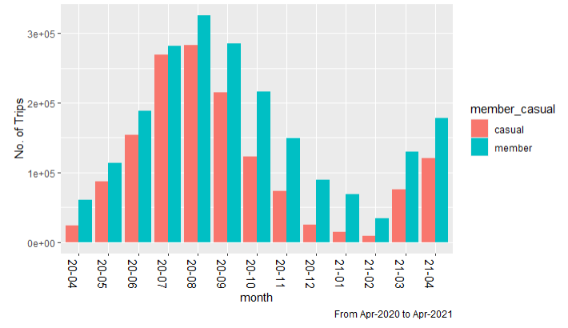
Total trips each member type does in a Week

Slide 6
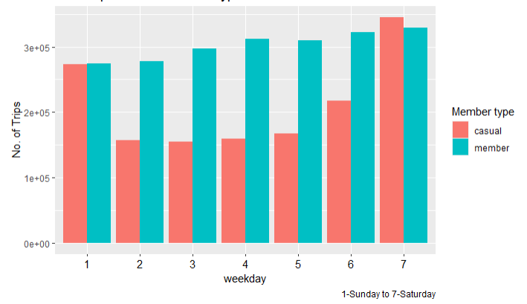
Total trips of each member type does in a week
Key Takeaway:
- Based from Average trips per month and Average trips per week. We can see that more annual members are using the service per month. However in a weekly basis, we can see a surge of casual riders during the weekends, Saturday and Sunday but most of the days in the week is still dominated by the annual members.

Slide 7
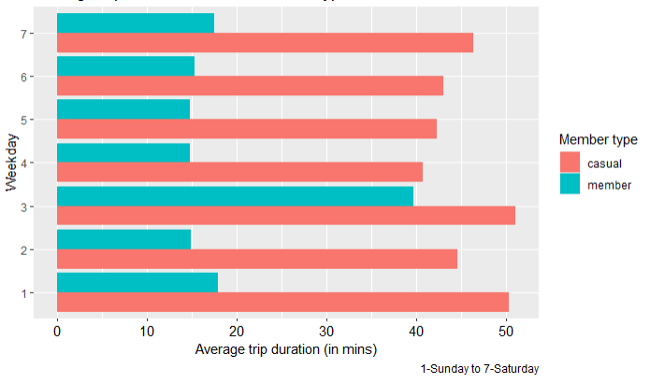
Average trip duration of each member type
Key Takeaway:
- Casual Members take longer trips compared to annual members even during weekdays.

Slide 8
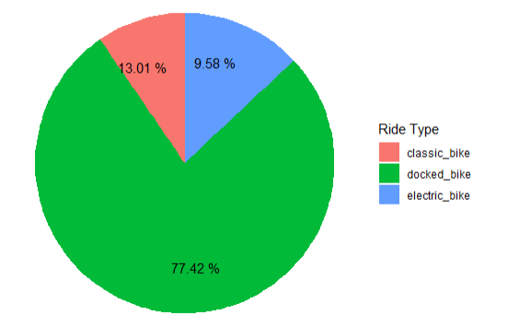
Ride type among Casual Members
Key Takeaway:
- Most casual members still use docked bikes

Slide 9
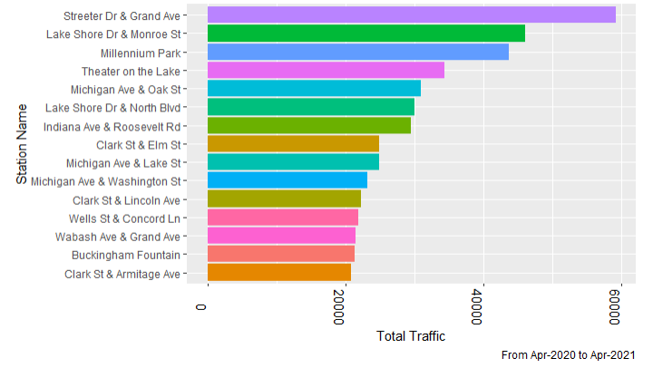
Stations with heavy foot traffic
Key Takeaway:
- The visualization shows the top 15 stations with heavy traffic from casual riders with Top 3: Streeter Dr & Grand Ave, Lake Shore Dr & Monroe St, and Millenium Park.

Slide 10
Conclusion
Based on the processes and analysis done on the data set provided, we can therefore conclude the following takeaways from the data:
1. There are more rides taken by annual members than casual members every month.
2. There is a surge in casual rider trips during the weekends in a week.
3. Casual riders take longer trips than annual riders for every trip
4. Majority of casual riders use docked-type bicycle

Slide 11
Recommendation
The following recommendations might help the business when preparing a marketing campaign to attract more annual members:
1. Prepare marketing campaigns based on weekend promos
2. It is also possible to test the marketing campaign on the stations with high traffic
3. Rides with longer trip duration can also be rewarded on annual members to attract casual riders as they have longer trip duration.

Slide 12
Appendix: Data Cleaning Steps
The following steps were performed on each csv file containing monthly data were taken to ensure that the data is prepared for Analysis.
1. Removed Duplicates in Excel under Data -> Remove Duplicates
2. Removed Rows with Blank Entries. For this I added formula below to each row, a new column, that counts if a cell in the row is empty. Then, simple filtering will show the rows tagged as "del" and delete all the shown rows.
=IF(COUNTA(A2:M2) < 13 , "del", "ok")
3. Simple Filtering in Excel for each column will show the values each column should have, this was applied to member_casual and rideable_type column.
4. Properly transform the data types of the columns. Set the latitudes to number and set ride_id, station_names, rideable_type, and member_casual to text
5. Get the trip duration using the started_at and ended_at columns and create a new number column, trip_duration. I used the following formula to ensure that the trip_duration will yield a positive format and in minutes with F2 containing the ended_at and E2 with started_at.
=IF(F2 > E2, F2-E2, E2-F2) * 24 * 60
6. Insert a month Column with the respective month and abbreviaton. Apr, 20. Please take note that this is a mistake in purpose to show data transformation/data cleaning in R later on.
7. Insert a weekday column using =WEEKDAY(E2, 1) which will yields numbers from 1 (Sunday) - 7 (Saturday),

